Slide 1
Investigation on Methods of Nanocellulose extraction
By : Tanima sharma
Akshay Srivastava

Slide 2
Current stage of the project
Cellulose has been extracted from bagasse.
The bagasse was dried, pulverized, sieved and then treated with 16% NaOH(aq). Furthermore it was bleached using 30%H2O2 to oxidise any remaining non-cellulosic components.
Extracted cellulose was washed and dried.

Slide 3
Extensions to the current project.
Extensions to the current project are as follows:
Convert the extracted cellulose to nanocrystalline cellulose (NCC).
Investigate methods to scale up the adapted approach in the conversion of Cellu. to NCC.

Slide 4
Properties of nanocellulose
Its tensile strength is about 500MPa similar to that of aluminium.
Its stiffness is about 140–220 GPa, comparable with that of Kevlar.
Its strength/weight ratio is 8 times that of stainless steel.
Gas impermeable.
Extracted as a colloid, but can be moulded and then dried to for solid structures.
Can conduct electricity.
Tranparent.

Slide 5
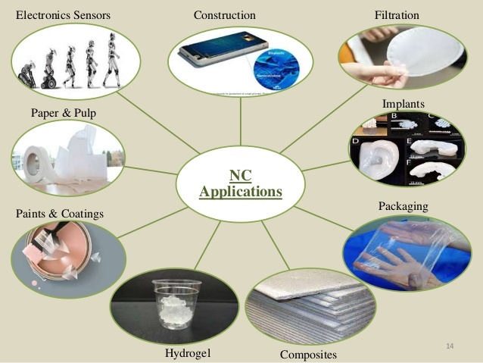
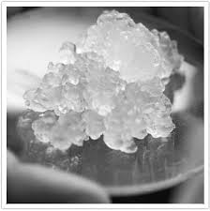
Applications of nanocellulose
Nanocellulose crystals

Slide 6
Current methods of production of cellulose to NC
Currently methods that are used in order to convert cellulose to NC are:
Mechanical treatment such as high pressure homogenizing, cryo-crushing, grinding/slurry pulverizing (using static/rotary grinders) and high intensity ultrasonication.
Chemical hydrolysis (using acid, acid gas and metal salt catalysis) and treatment with ionic liquid.
Often chemical hydrolysis is used to pre-treat the cellulose for mechanical techniques. Furthermore, enzymatic hydrolysis can also be utilized to pre-treat cellulose feed by reducing DP of the same and consequently increase the crystallinity of the cellulose.

Slide 7
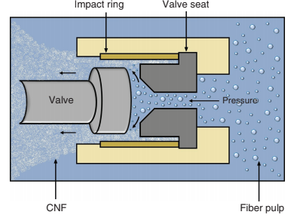
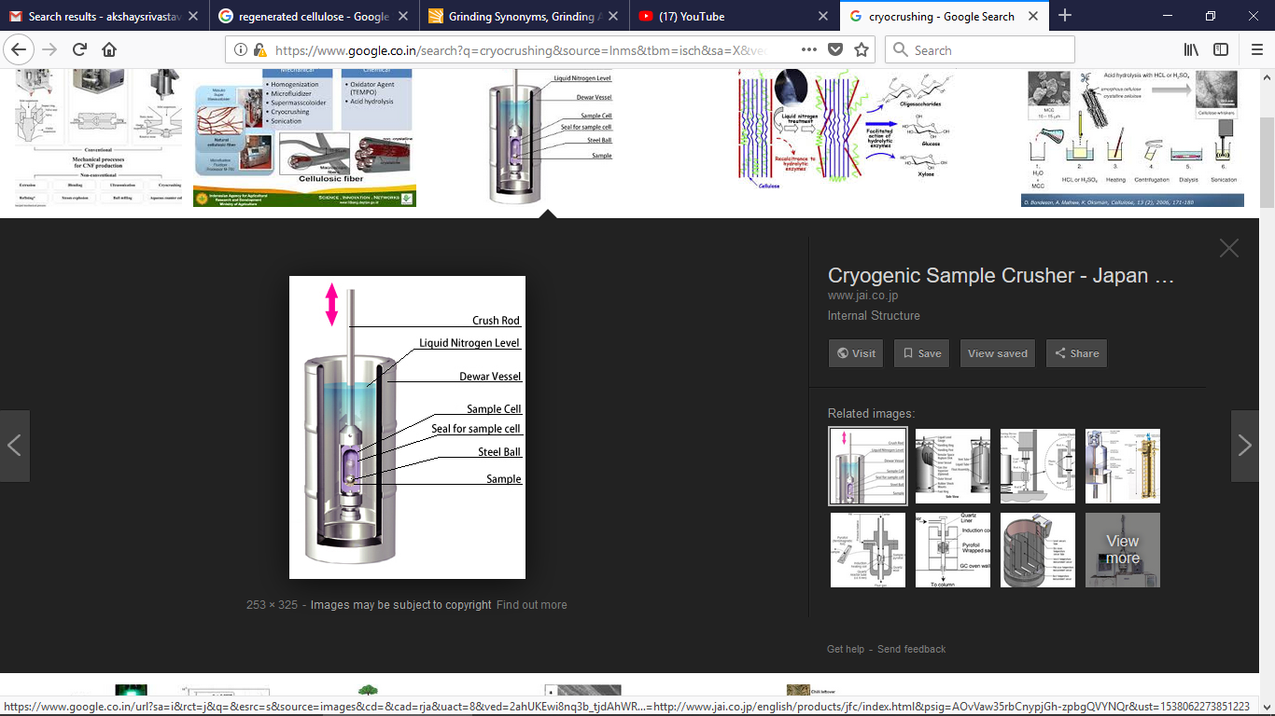
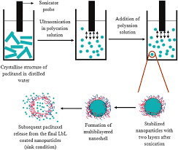
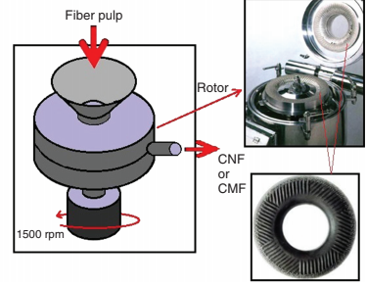
Current methods of production of cellulose to NC
Mechanical treatment techniques:
High Pressure homogenizing.
Cryo-crushing.
Grinding.
High intensity ultrasonication.
HIGH PRESSURE HOMOGENIZING
CRYO-CRUSHING HIGH INTENSITY ULTRASONICATION GRINDING

Slide 8
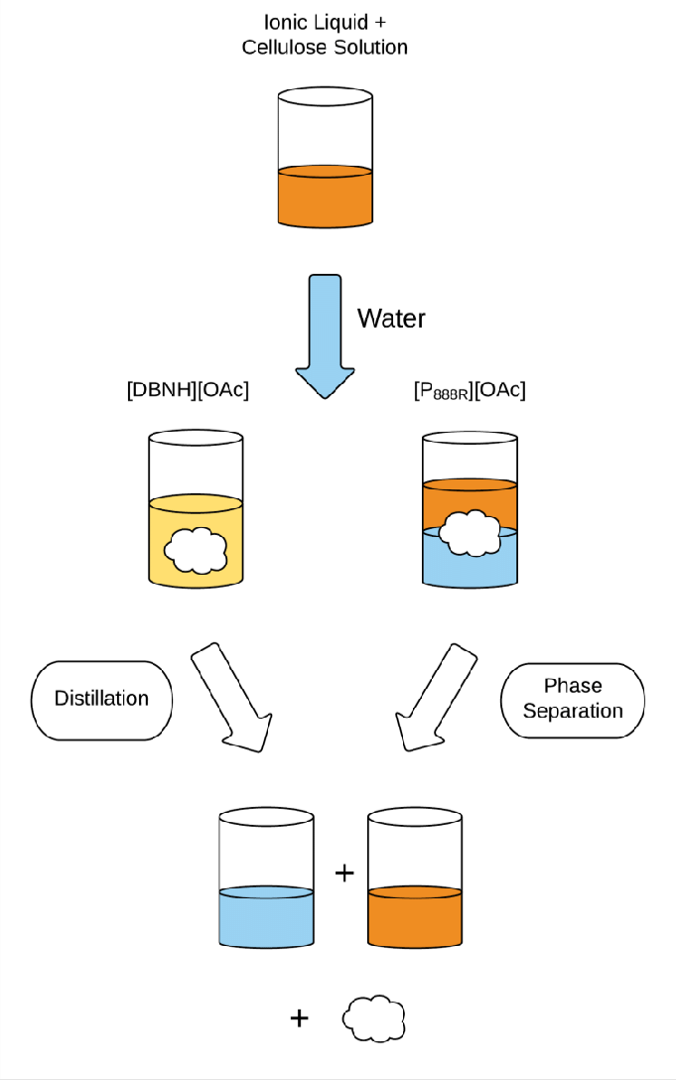
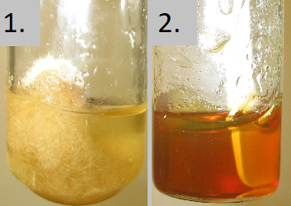
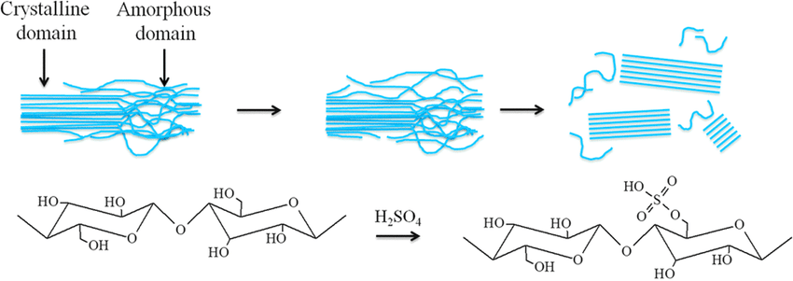
Current methods of production of cellulose to NC
Chemical hydrolysis:
Acid based hydrolysis using strong mineral acids, acid gases, solid acids and metal salt catalysis.
Ionic liquid treatment.
disordered amorphous domains and local interfibrillar contacts of cellulose are preferentially hydrolyzed, whereas stable crystallites remain intact and can be isolated as rod-like nanocrystalline particles
Cellulose in ionic liquid forms dissolute into a gel. Ionic liquids are consumed in the process of disintegration of cellulose

Slide 9
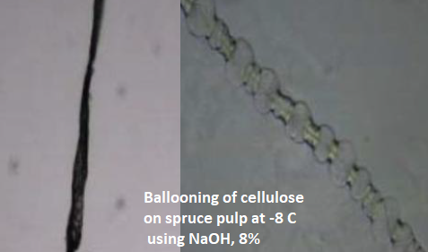
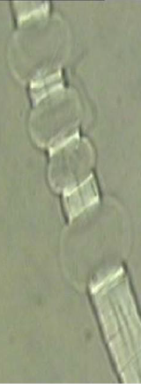
Speculated method of production of cellulose to NC
NaOH, NaOH/Urea and NaOH/Urea/Thiourea solvent
Cellulose is soluble in a number of solvents, out of which, combination of above do so by swelling the cellulose strands.
Upon uneven swelling, balloons are forms and the crystalline cellulose remain intact.
Upon application of an electric potential, due to the rapid migration of the basic solution out of the balloons, the sacs will burst prematurely and leave the negatively charged crystalline cellulose behind. These will migrate towards the anode and hence a concentrated colloid of NCC will form which can be extracted.

Slide 10
Advantages of speculated method
Unlike chemical and mechanical method, this method is much less expensive.
Since the maturing of the balloons is avoided, the method is much fast as compared to enzymatic disintegration.
Much less energy is consumed.
Since a huge amount of chemicals can be recycled, the process is also very eco-friendly
Since NaOH is the only reactant involved from Bagasse to Nanocellulose, separation processes are not rendered complicated.

